Slide 1
CS6120 Project
Amazon Product Review Score Prediction
Group 9:
Minjie Shen, Jiamu Li, Jing Zhou

Slide 2
Introduction
The goal of our project is to develop a model that can accurately predict the product review score associated with a review based on the review text from customers.
This project has significant practical application for e-commerce platforms, manufacture companies and rating website and agencies, since it can help them automate the rating process and quantify the rating reviews from customers accurately and provide insights into customer satisfaction.

Slide 3
Introduction
Dataset:
Amazon Review Data - Data of amazon reviews on products (Games and Musical Instruments).
BOW
Converts a sentence into a numerical vector representation
Frequency of each word
BERT
Contextual word embeddings
The word presentation changes based on the sentence it appears

Slide 4
Method
Step 1
Step 2
Step 3
Step 4
Step 5
Pre-processing(Clean Data)
Upsampling the minority
Create BOW and BERT models respectively
Training models
Use models to predict score for a input text

Slide 5
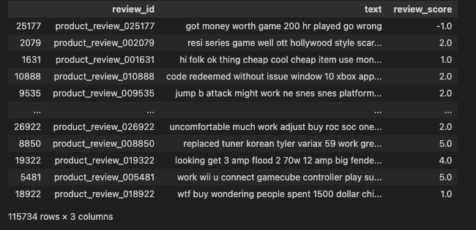
Data Clean & Upsampling the minority
Data Clean:
Converting to Lowercase
Removing Non-Alphanumeric Characters, Punctuation, Links, Stop Words
Tokenization
Lemmatization
Df_upsampled:
review_id(unique identifier for each review)
text(review content)
review_score(a numerical rating or sentiment score associated with each review)

Slide 6

BOW model
Input: vectorized text ------> Output: predicted score
Step 1
Step 2
Step 3
Tokenization
Vocabulary Creation
Vectorization
It has one hidden layer with 128 neurons followed by the ReLU activation function. To ensure that outputs fall into a range from 0 to 5 (here 0 represents -1 score), the model applies the sigmoid function on the output and multiplies it by 5. We use MSELoss as the criterion and Adam as the optimizer. We train the model with 512 batch size for 20 epochs to obtain a good result.
Notes:
The basic idea behind the BOW model is to represent a document as an unordered set of words, disregarding grammar and word order but maintaining the frequency of each word.
The first step is to break down the text into individual words, which is calCreate a vocabulary that consists of all unique words present in the entire corpus (collection of documents). Each unique word in the vocabulary is assigned a unique index.led tokenization. This process involves removing any punctuation or special characters and splitting the text into words.
For each document in the corpus, create a feature vector representing the frequency of each word in the vocabulary.
The length of the feature vector is equal to the size of the vocabulary, and each element in the vector corresponds to the frequency of the respective word in the document.
The result is a high-dimensional sparse vector, where most elements are zero
It has one hidden layer with 128 neurons followed by the ReLU activation function. To ensure that outputs fall into a range from 0 to 5 (here 0 represents -1 score), the model applies the sigmoid function on the output and multiplies it by 5. We use MSELoss as the criterion and Adam as the optimizer. We train the model with 512 batch size for 20 epochs to obtain a good result.

Slide 7
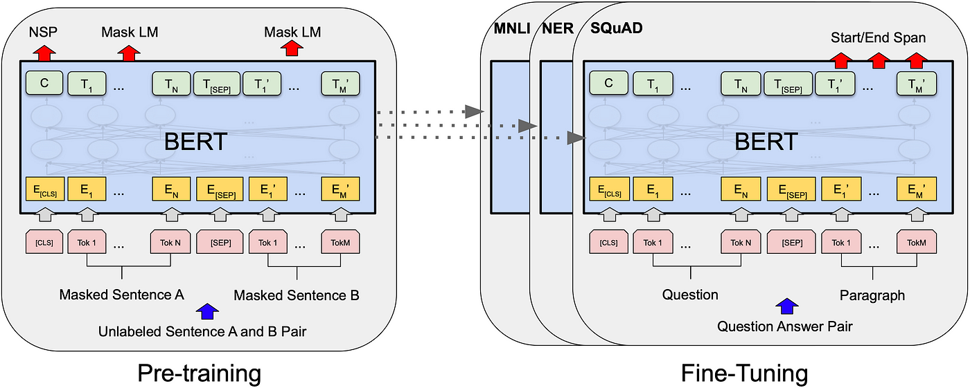
BERT model
Notes:
We use BertForSequenceClassification’s pretrained model bert-base-uncased from transformers library to train our data. This model is pretrained with masked language modeling and next sentence prediction. To train the model, we have to add attention masks and segments to the data. We use BertTokenizer tokenizer of bert-base-uncased model from transformers with 64 max sequence length to generate attention masks and segments. The criterion is CrossEntropyLoss and the optimizer is AdamW. We train the model with 128 batch size and 10 epochs to obtain a good result.

Slide 8
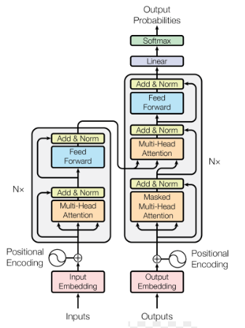
BERT model
We use BertForSequenceClassification’s pretrained model bert-base-uncased from transformers library to train our data. This model is pretrained with masked language modeling and next sentence prediction.
To train the model, we have to add attention masks and segments to the data. We use BertTokenizer tokenizer of bert-base-uncased model from transformers with 64 max sequence length to generate attention masks and segments.
The criterion is CrossEntropyLoss and the optimizer is AdamW.
We train the model with 128 batch size and 10 epochs to obtain a good result.
Notes:
We use BertForSequenceClassification’s pretrained model bert-base-uncased from transformers library to train our data. This model is pretrained with masked language modeling and next sentence prediction. To train the model, we have to add attention masks and segments to the data. We use BertTokenizer tokenizer of bert-base-uncased model from transformers with 64 max sequence length to generate attention masks and segments. The criterion is CrossEntropyLoss and the optimizer is AdamW. We train the model with 128 batch size and 10 epochs to obtain a good result.

Slide 9
Predict score & Evaluation (Result)
We used loss, accuracy, precision, recall and f1 score to evaluate the performance.
We also used two models to predict new reviews to compare which one performs better.

Slide 10
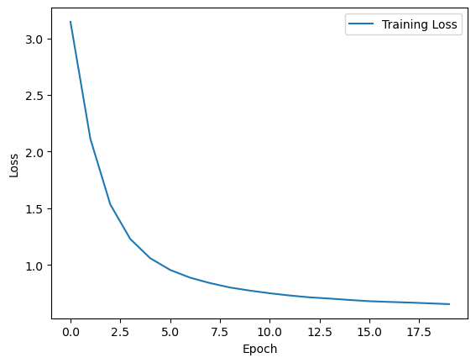
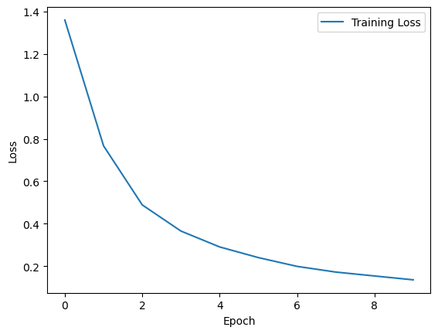
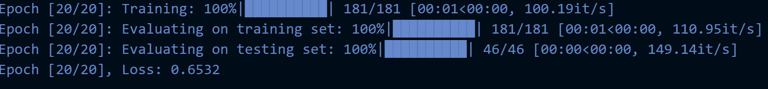
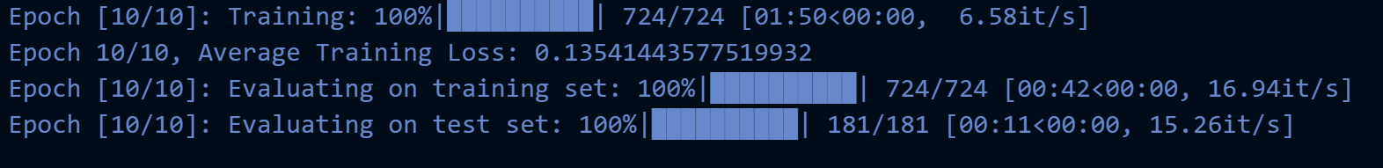
Loss
BOW
BERT

Slide 11
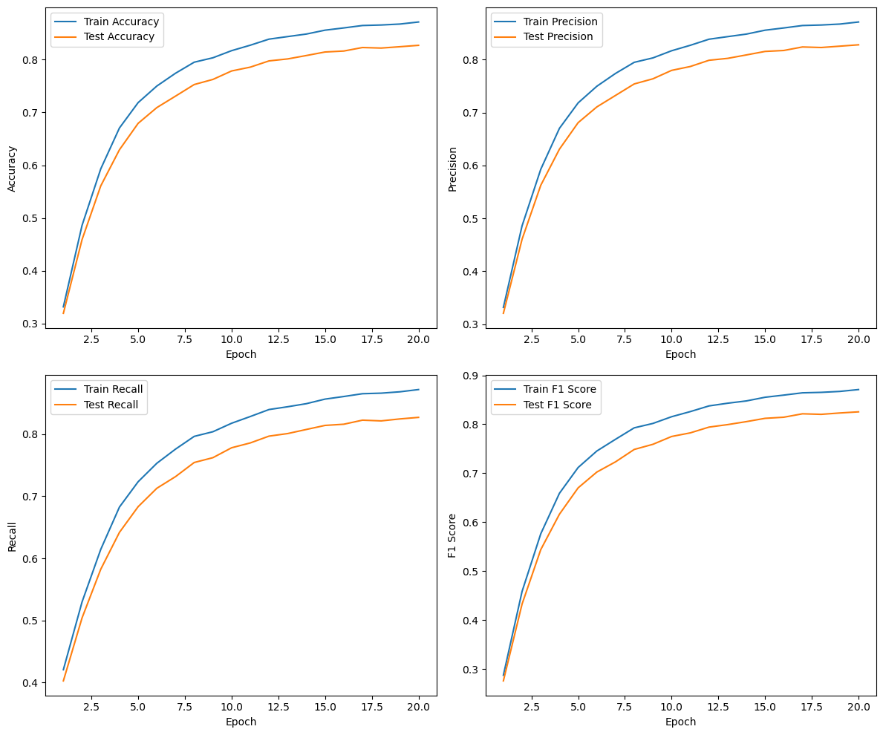
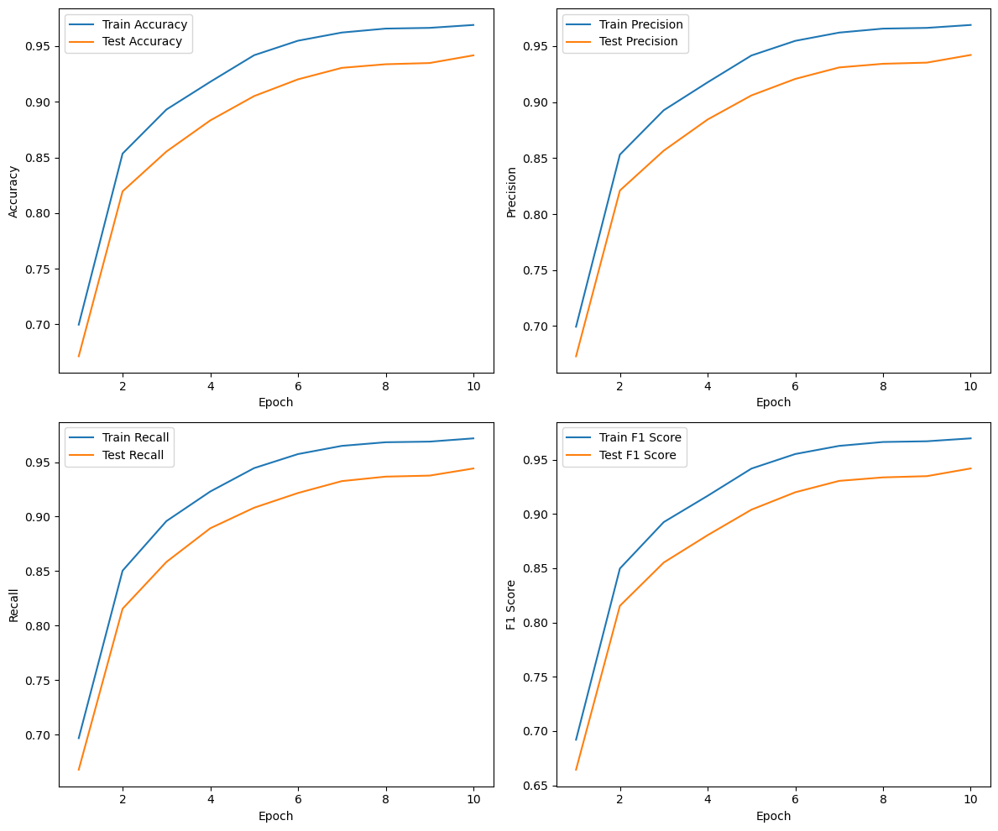
Accuracy, Precision, Recall. F1-Score
Accuracy: 0.827148226552037
Precision: 0.8280949958785652
Recall: 0.8269970288736789
F1 Score: 0.8254189944358238
Accuracy: 0.9416771071845164
Precision: 0.9421314161743138
Recall: 0.9441547223989453
F1 Score: 0.9418438017259069
BOW
BERT

Slide 12
Predict new reviews
This item is perfect
BOW: 4
BERT: 5
This item is awful
BOW & BERT: 1

Slide 13
Conclusion
BERT performs better than BOW on naive neural network.
BOW might have a better performance by adjusting the structure or fine-tuning parameters.

